Slide 1



Welcome

Slide 2

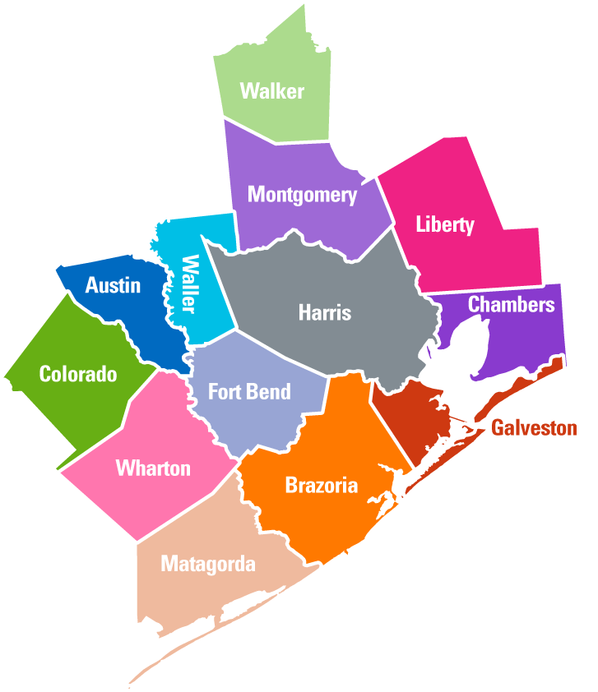
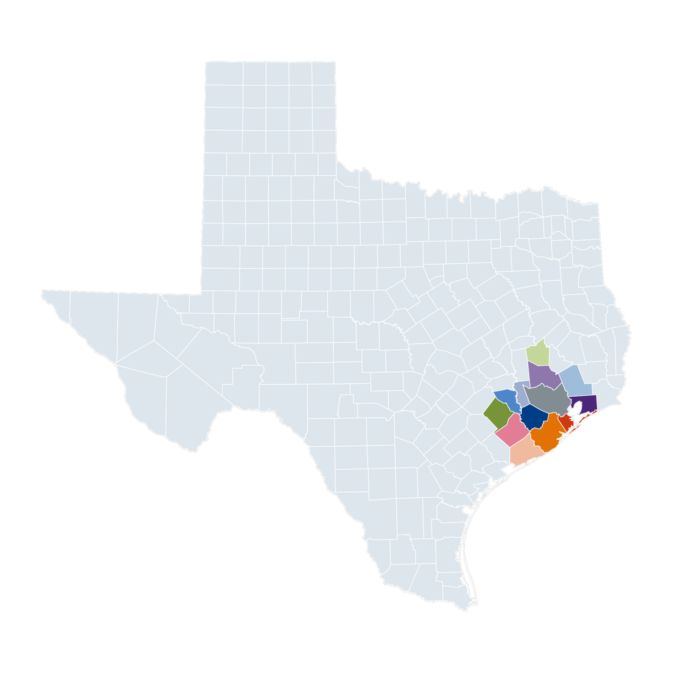
Who We Are
GCWB is the public workforce authority for 13 counties in southeast Texas
Over 7.5 million residents

Slide 3



27¢
Of every dollar of state GDP generated was from the Gulf Coast region.

Slide 4
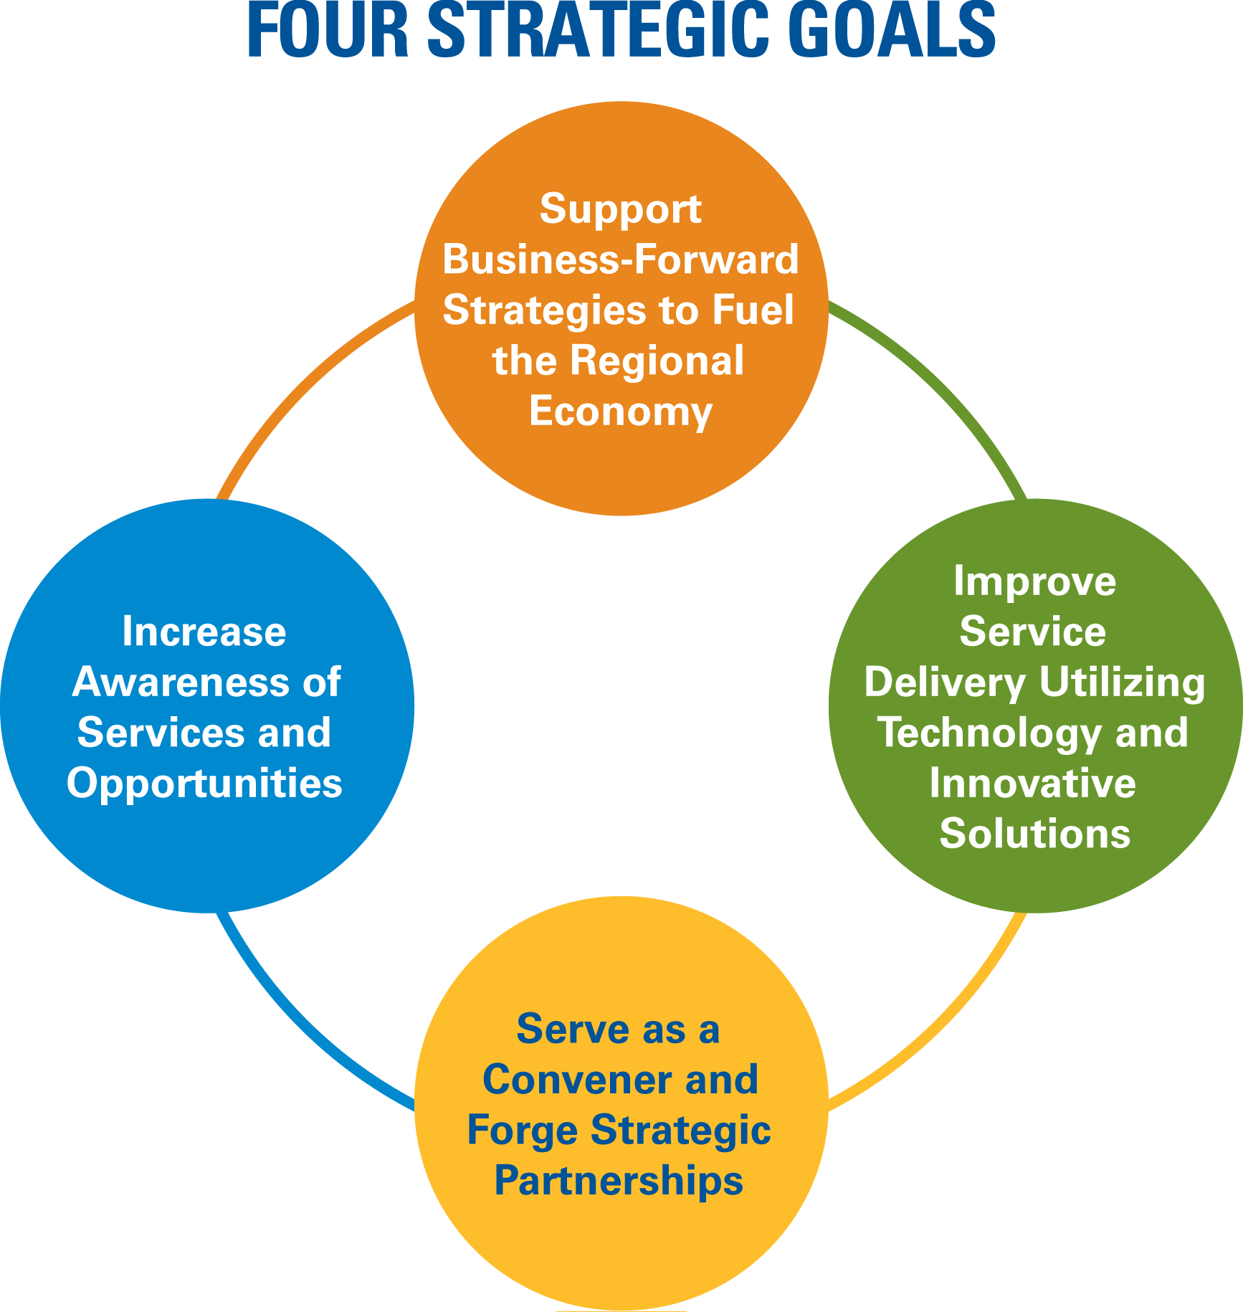
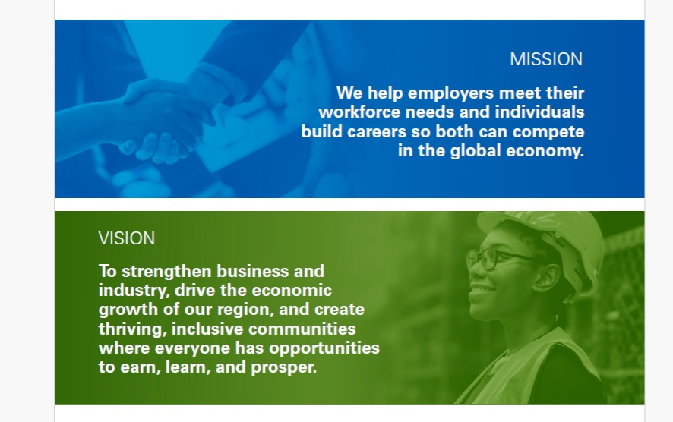
2024-2029 GCWB Strategic Plan

Slide 5
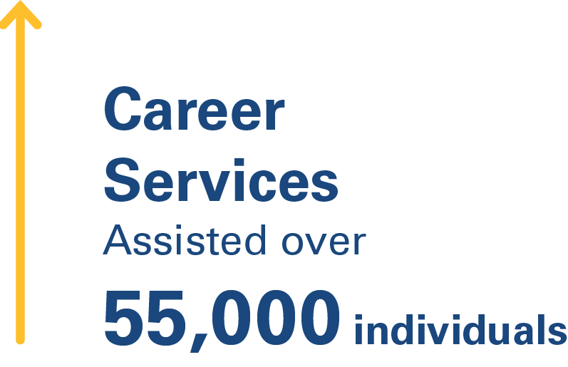
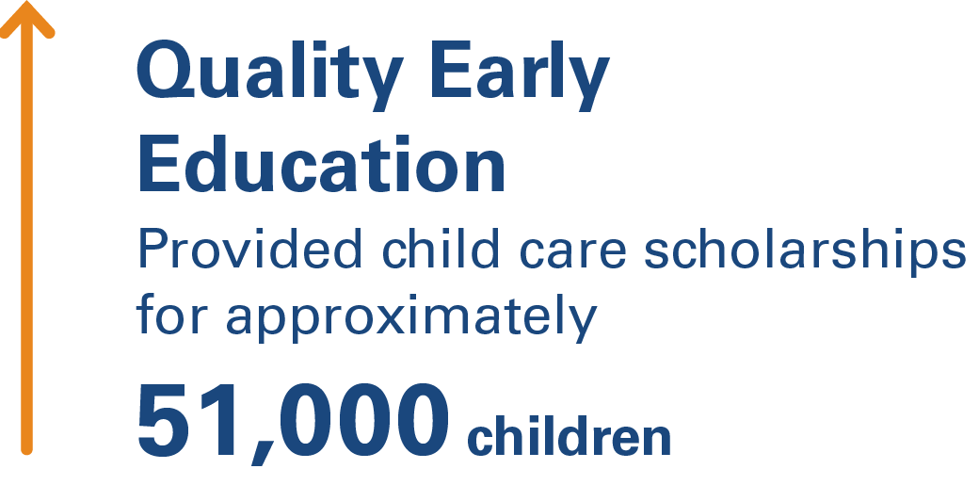
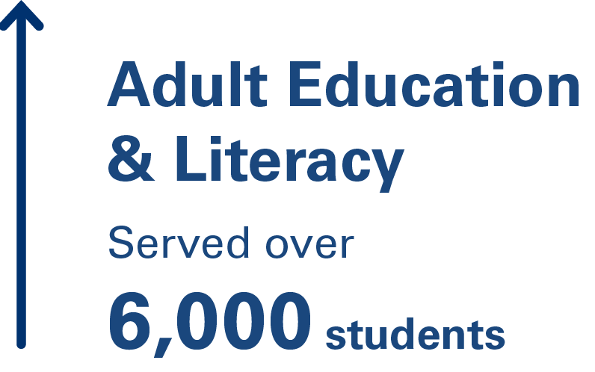
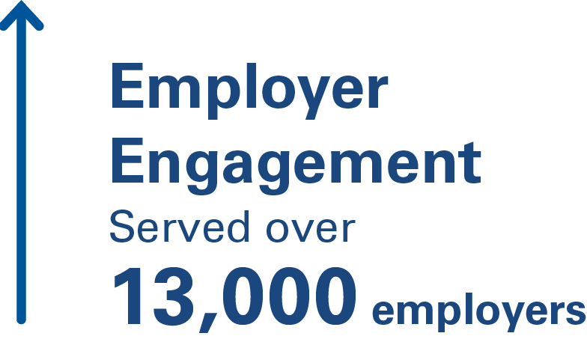
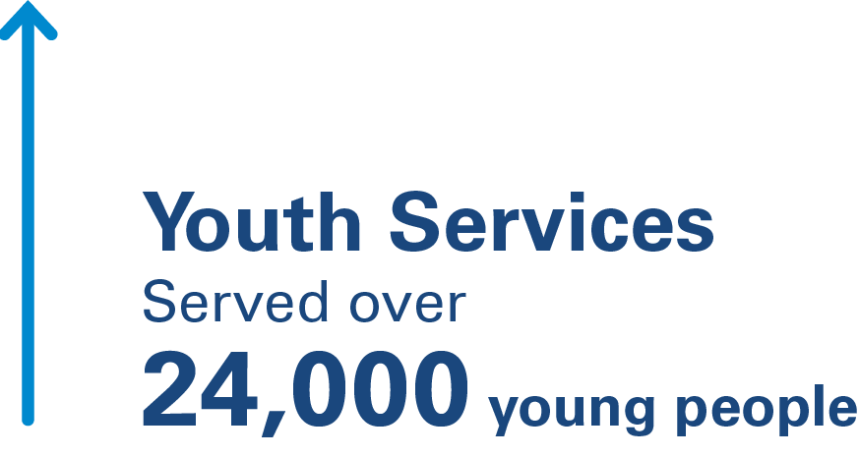
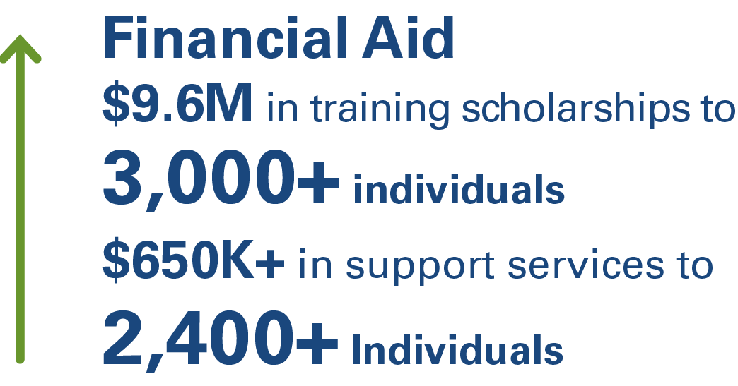
Our Scale of Impact

Slide 6





Employer Services
Healthcare & Life Sciences
Energy (Oil, Gas, Petrochemical, Renewables)
Advanced Manufacturing
Construction & Skilled Trades
Information Technology & Digital Technology

Slide 7


Slide 8

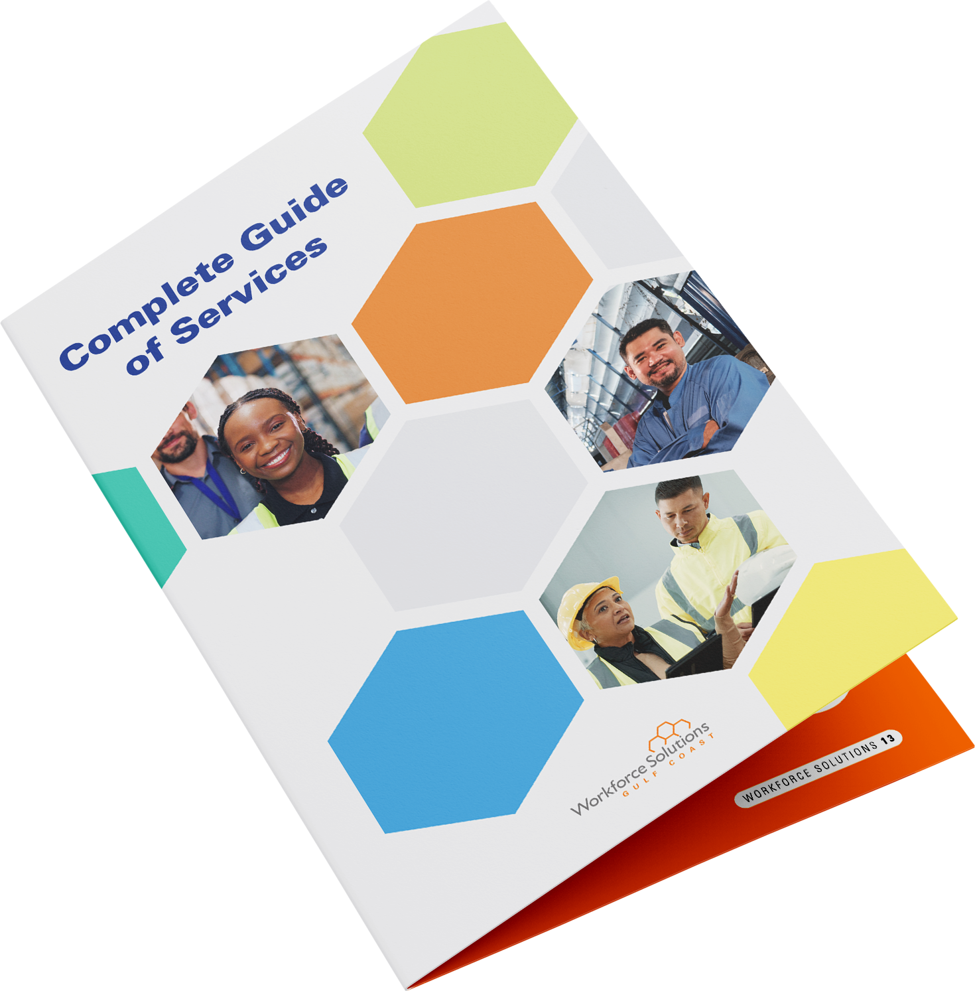
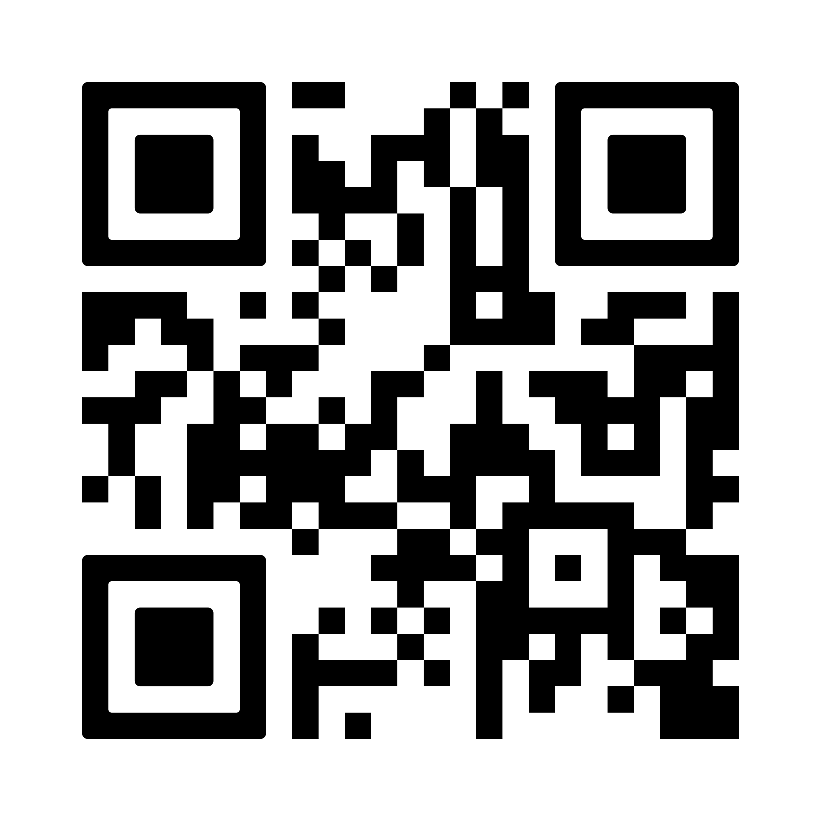
Scan to read

Slide 9

Texas Workforce Commission
Gulf Coast Workforce Board
Gulf Coast Provider Network
Career Advising, Assessment & Scholarships
Training & Certifications
Adult Education & Literacy
Notes:
Strengthen partnerships
Continue service in underserved and unfunded counties by activating partnerships with community organizations and increasing our services through different modalities.
Tailor instruction to workforce needs
Design culturally responsive, locally adapted programs based on workforce needs.
Deliver flexible programming
Use a mix of face-to-face, hybrid, and virtual options to reduce access barriers in rural regions.
Leverage strategic partnerships
Collaborate with employers, ISDs, libraries, faith-based groups, and Chambers to host instruction in nontraditional rural locations.
Secure sustainable funding
Seek diversified funding streams beyond TWC allocations to maintain and grow services in high-need rural areas.

Slide 10













Slide 11











Slide 12
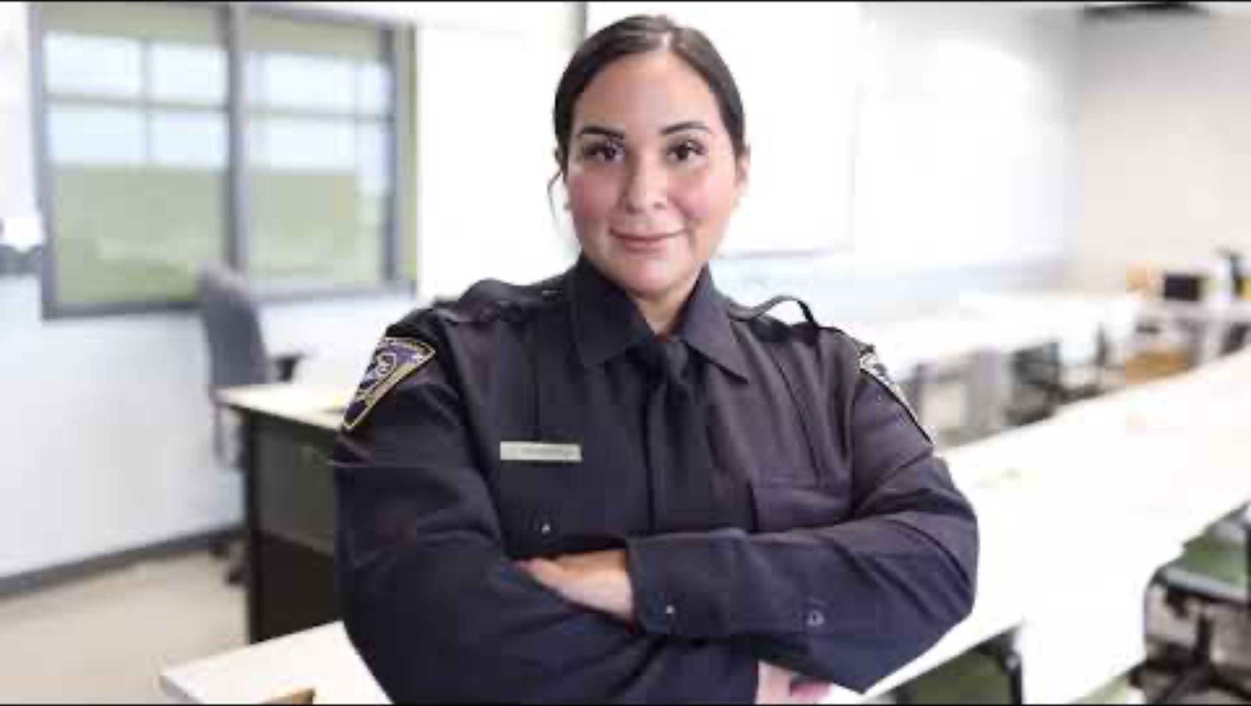

Slide 13
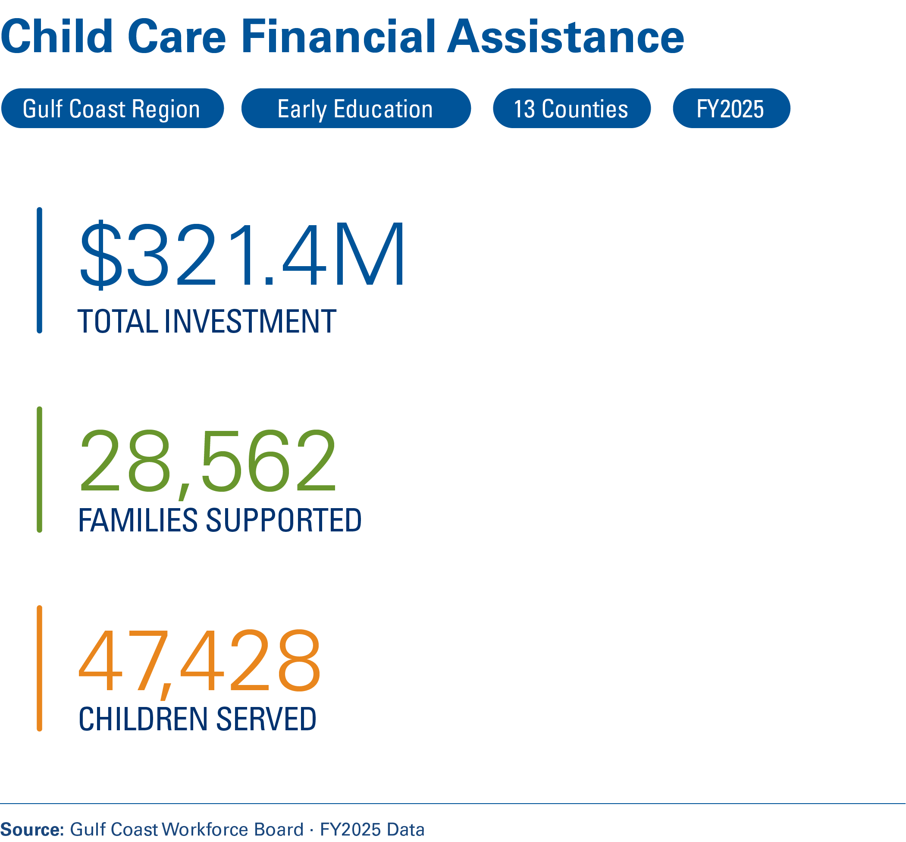
Childcare and Economic Mobility

Slide 14
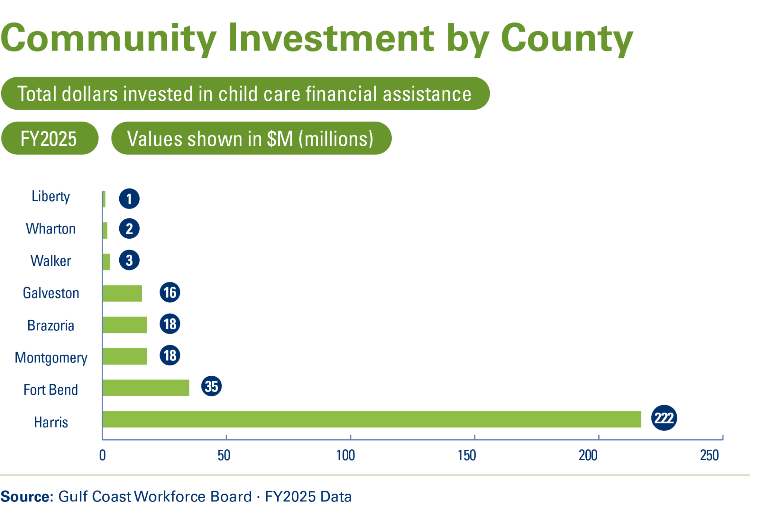

Slide 15
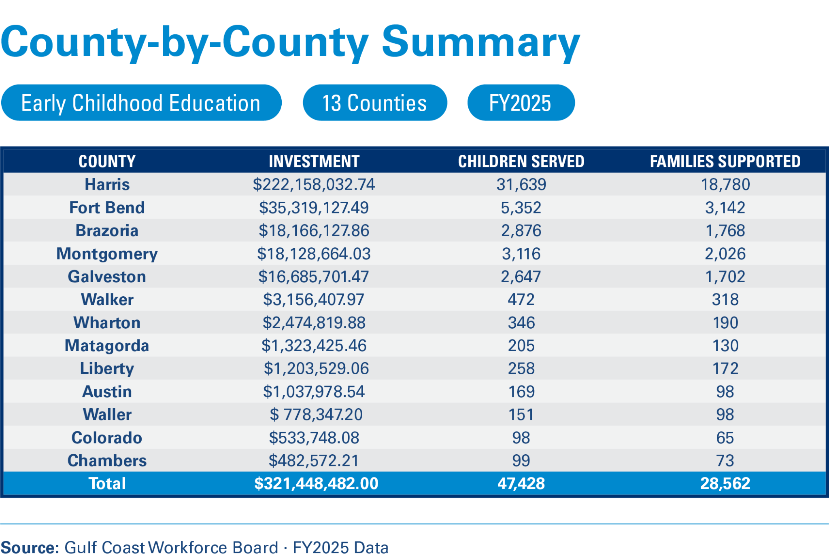

Slide 16
National Assessment of Educational Progress (NAEP) – The Nation’s Report Card (2024)
Reading
Math
Only 28% of Texas students read proficiently by 4th grade.
In Houston, over half of 4th graders are below basic in reading.
Only 24% of Texas 4th graders are proficient in math.
In Houston, just 20% of 8th graders are proficient in math.
If we want a competitive workforce, we must invest earlier, align systems, and treat childcare and education as core economic infrastructure.
Notes:
Houston’s NAEP results show modest gains but persistently low proficiency in reading and middle school math, meaning a large share of students are not reaching the foundational skill levels required for high-skill, high-growth jobs. For the Gulf Coast region, this translates into a structurally constrained talent pipeline, increasing reliance on remediation, employer training, and possible in-migration to meet workforce demand.

Slide 17
From Programs To Systems
Education
Workforce
Economic Development
Systems:
Align Supply (Education)
Convert to Earnings (Workforce)
Stimulate Demand (Economic Development)
Future Readiness
Talent Pipeline
Talent Competitiveness
Economic Mobility at Scale
Notes:
Education without employer demand produces underemployment.
In economic development, capital follows talent. Without talent, investment slows.
Disconnected workforce systems produce placements. Aligned systems produce mobility.
Short-term placements are not the same as long-term wage growth.
When supply aligns with demand, investment risk drops.
When investment grows, high-skill wages rise.
When wages rise and are sustained, intergenerational mobility probability increases.

Slide 18
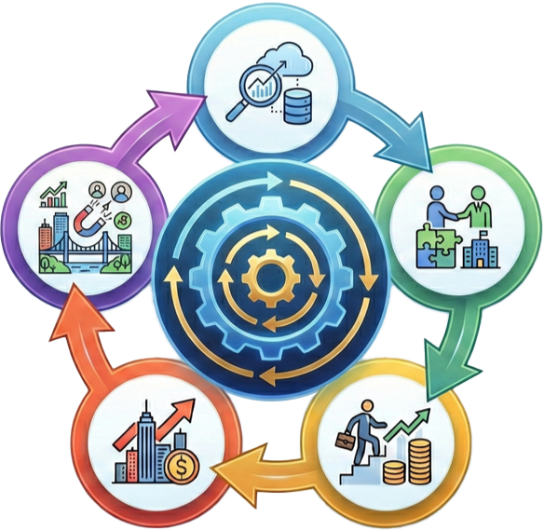
The Regional Prosperity Flywheel
A self-sustaining cycle where momentum in one area accelerates all others.
1. Better data
Leveraging real-time labor market intelligence and predictive analytics.
5. A Stronger, More Resilient & Attractive Community
Creating a high-quality 'talent magnet' that drives business relocation, new talent, and regional growth, restarting the cycle.
2. Better Partnerships
Fostering deep collaboration between industry, education, and community stakeholders.
4. Stronger Regional Tax Base
Generating increased public revenue through economic growth and individual prosperity.
3. Higher Wage Placements
Connecting skilled talent with high-growth, family-sustaining career pathways.

Slide 19
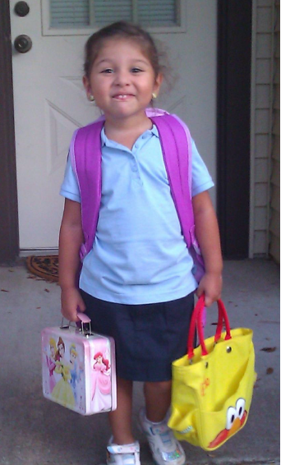
2013
Children have only one chance.
We must provide a consistently safe and rigorous education for all.

Slide 20
Call to Action

Slide 21
Roundtable Discussion

Slide 22
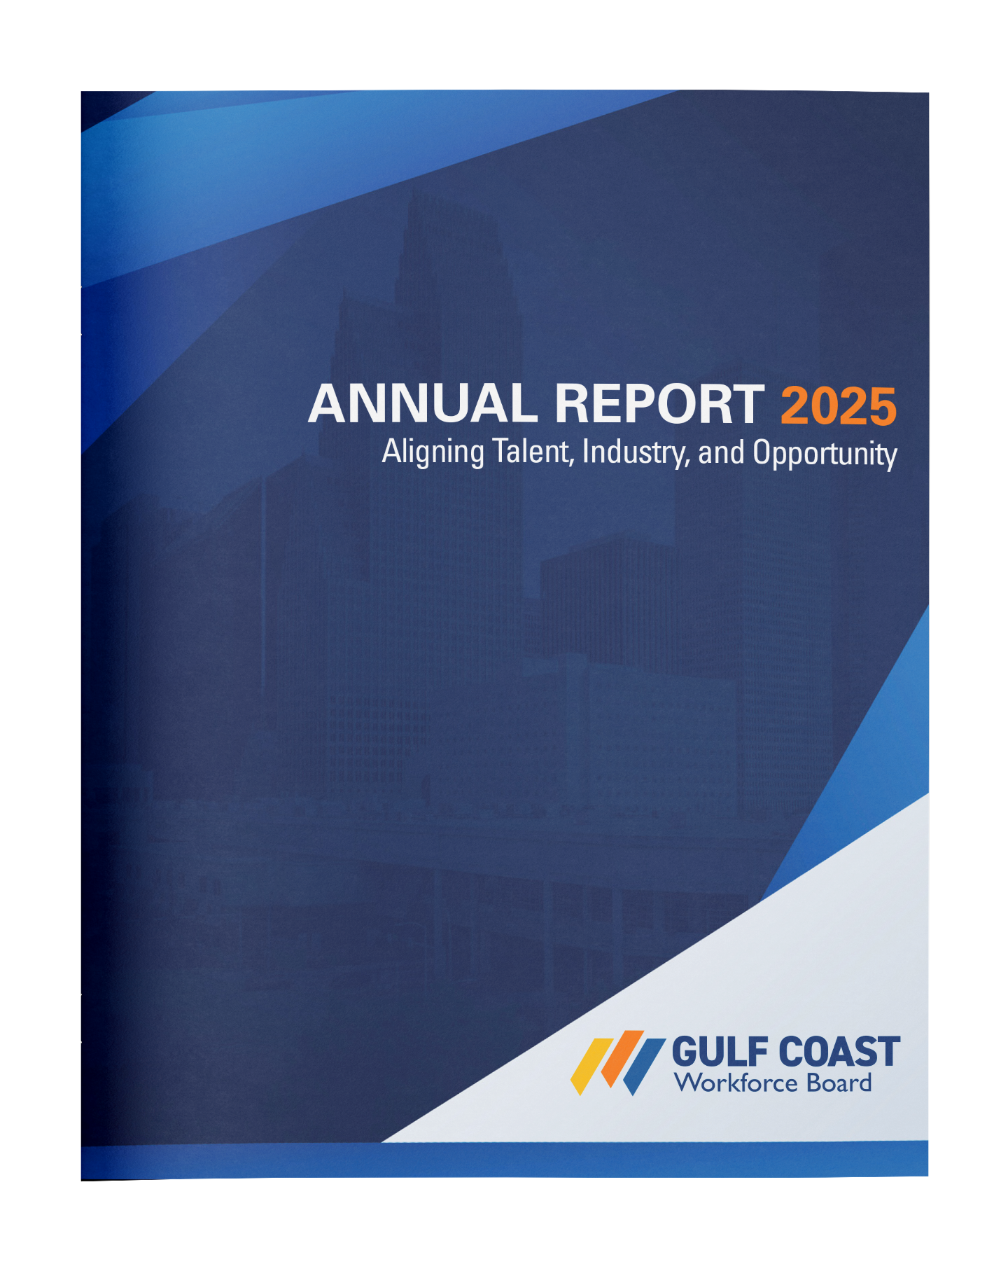
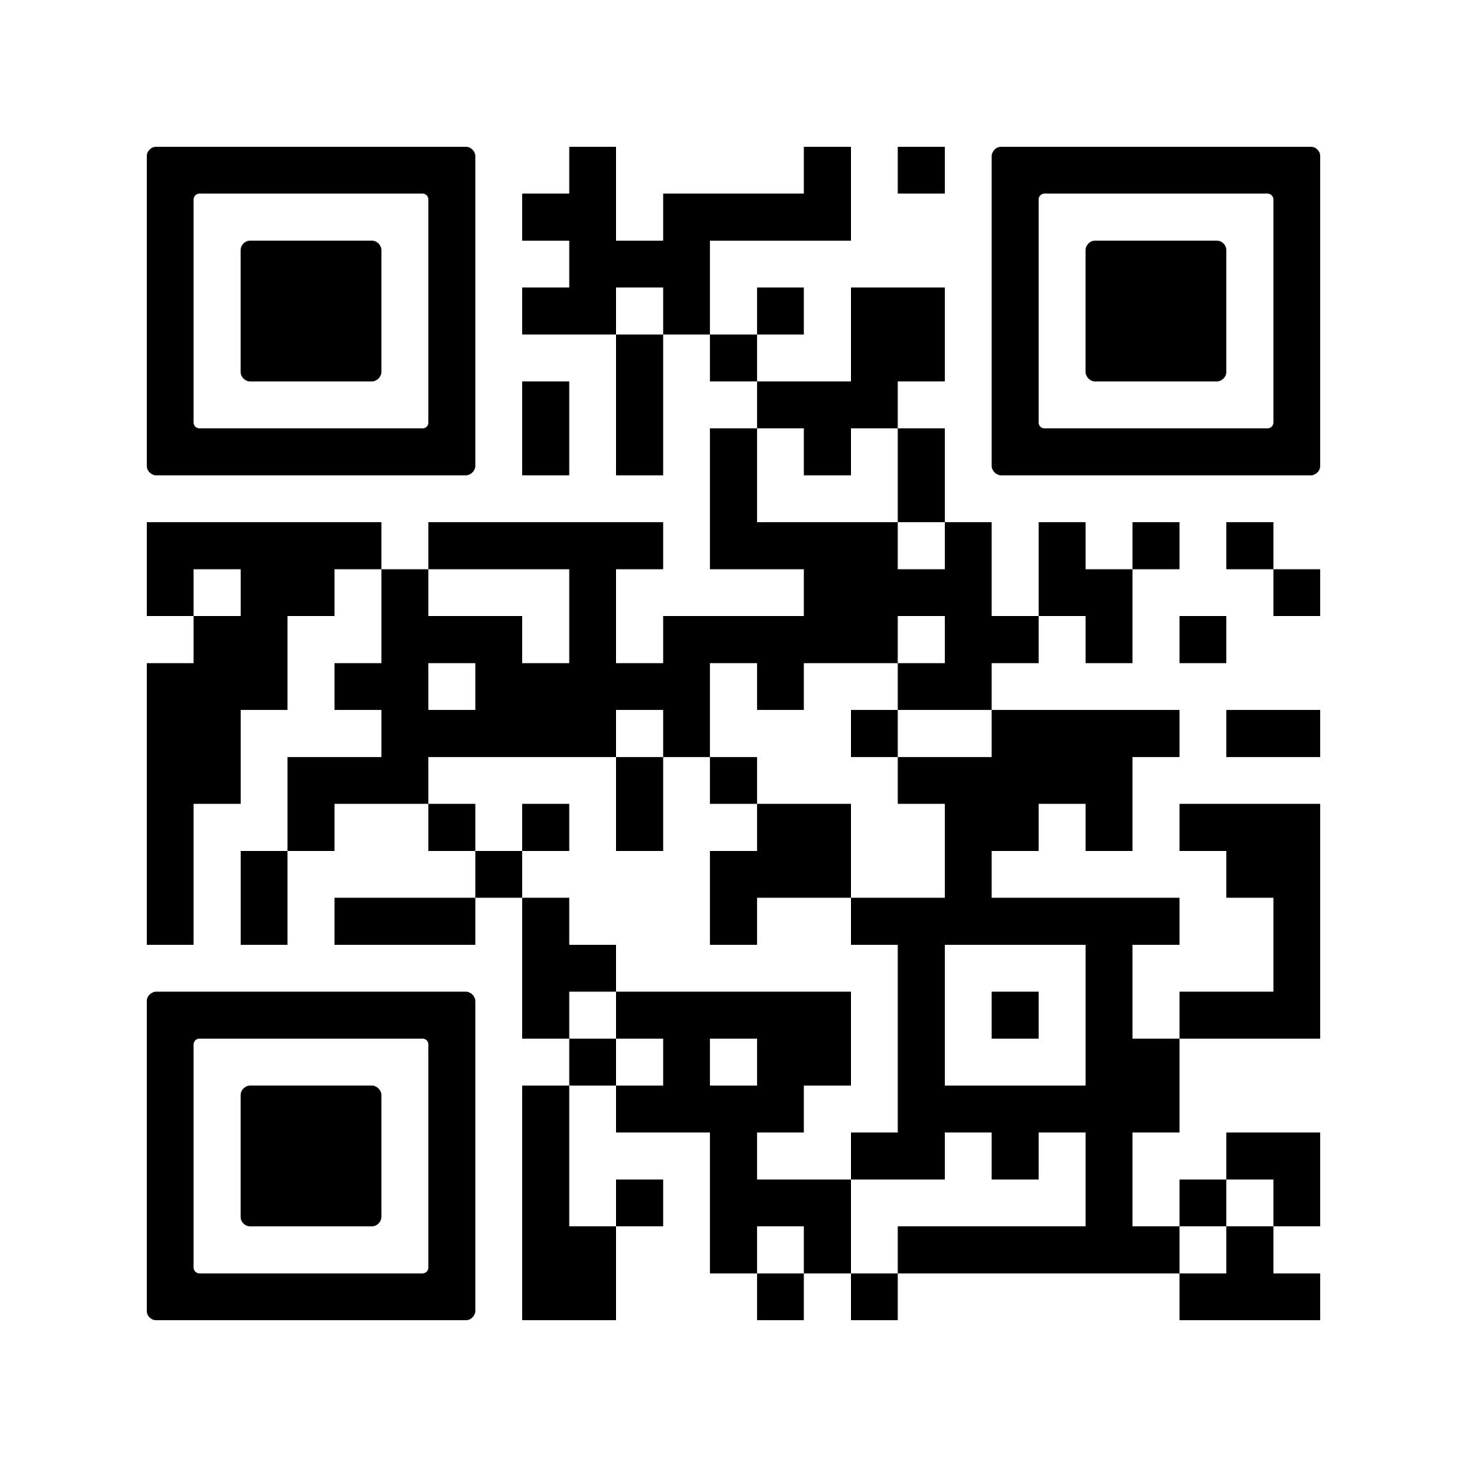
Scan to read

Slide 23
Thank You!
Notes:
Strengthen partnerships
Continue service in underserved and unfunded counties by activating partnerships with community organizations and increasing our services through different modalities.
Tailor instruction to workforce needs
Design culturally responsive, locally adapted programs based on workforce needs.
Deliver flexible programming
Use a mix of face-to-face, hybrid, and virtual options to reduce access barriers in rural regions.
Leverage strategic partnerships
Collaborate with employers, ISDs, libraries, faith-based groups, and Chambers to host instruction in nontraditional rural locations.
Secure sustainable funding
Seek diversified funding streams beyond TWC allocations to maintain and grow services in high-need rural areas.

